Slide 1
Air Quality Dashboard
201824590 조승현
WEB APPLICATION PROGRAMMING (062)
2024.11.19

Slide 2
Demo

Slide 3
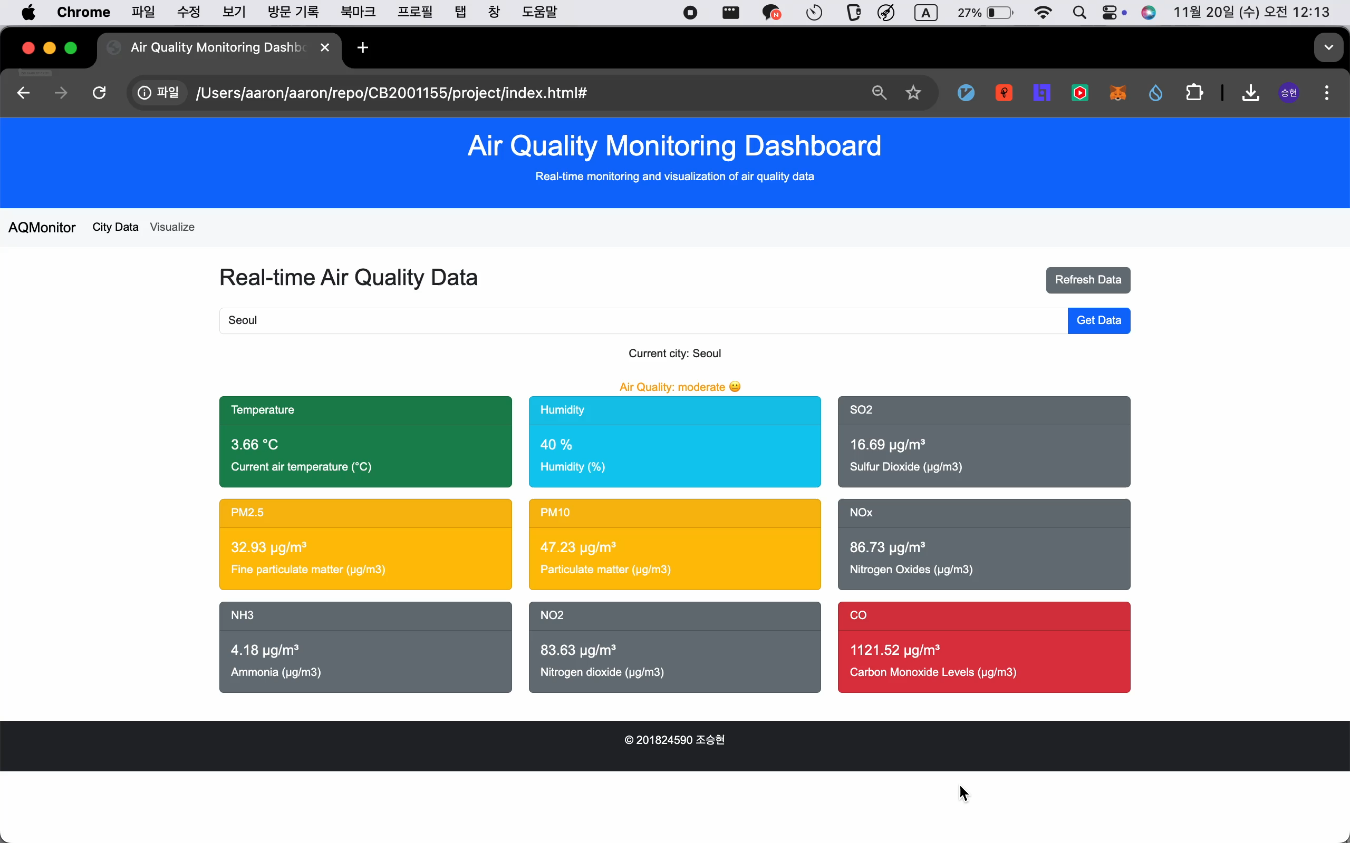

Slide 4
Table Of Contents
1. Layout
2. Key Features
3. Libraries used
4. TODO

Slide 5
Layout

Slide 6
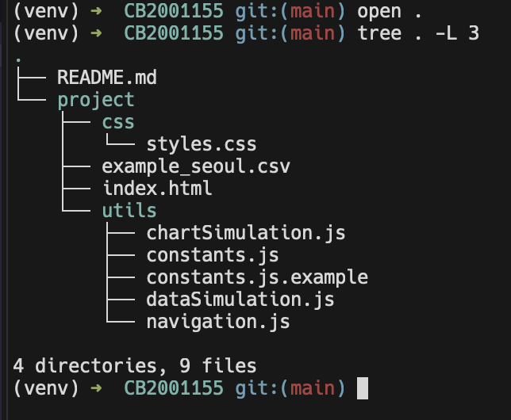
Project File Layout
css
html
JS

Slide 7
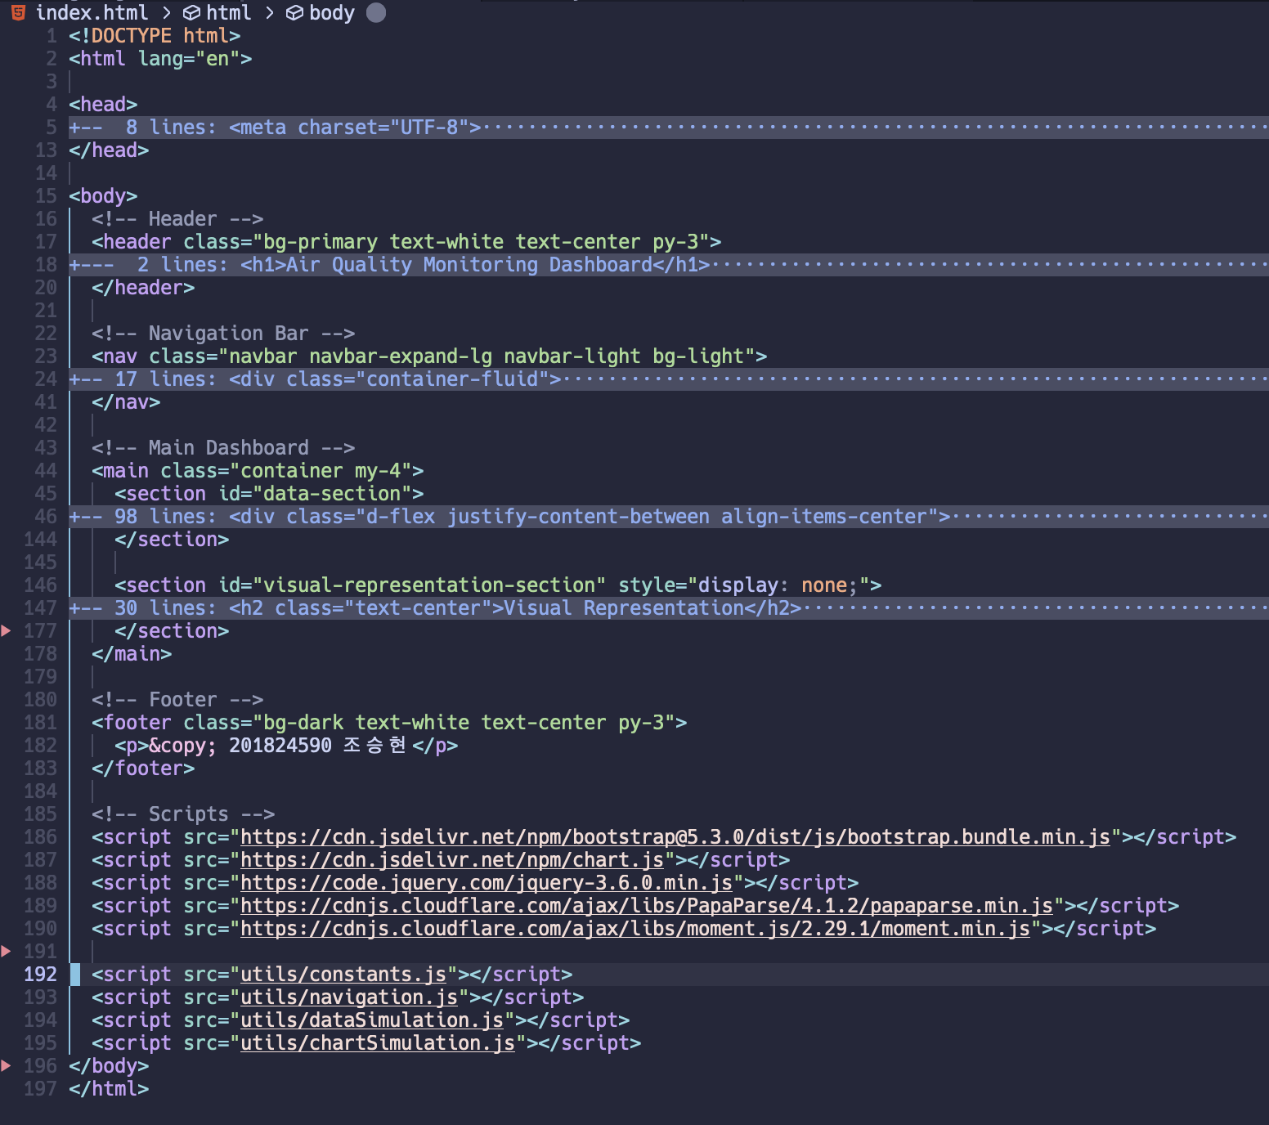
Project Layout Details (1/3)
Edited in VIM
HTML (structure)
Header
Nav
Main
> section (1)
> section (2)
Footer

Slide 8
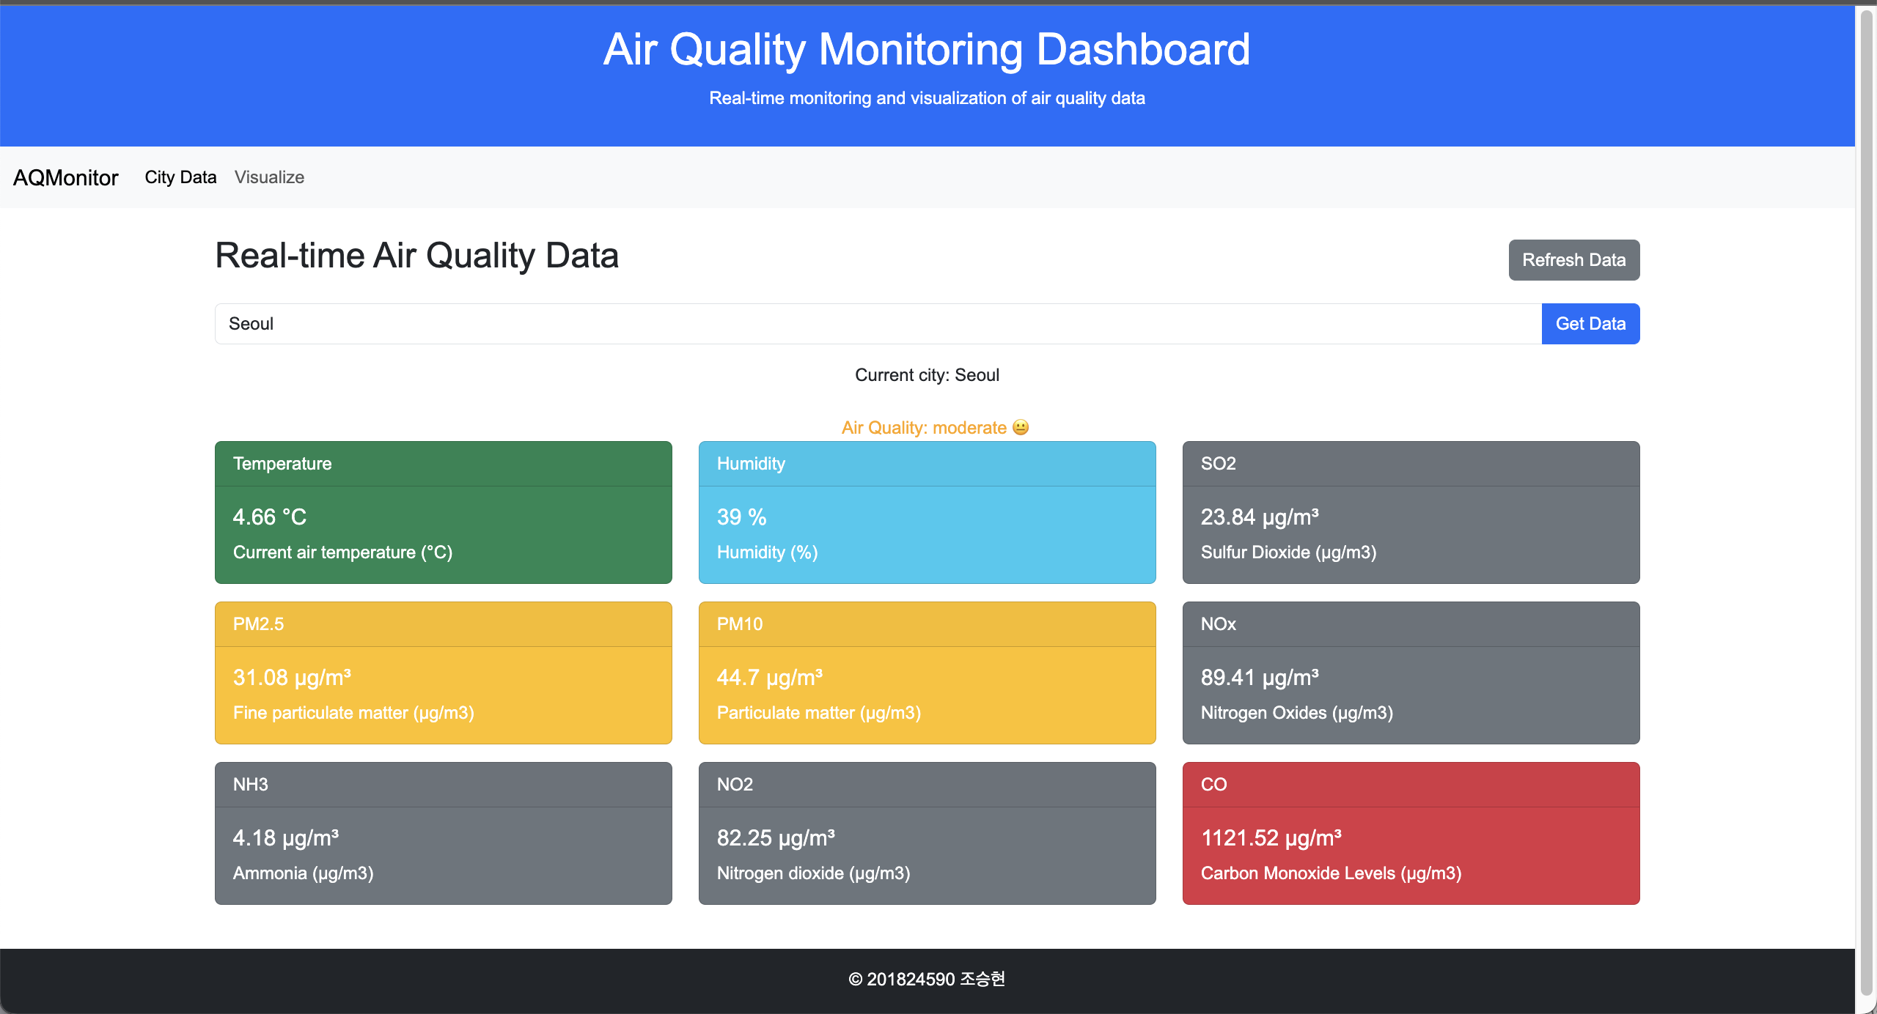
Project Layout
Header
Nav Bar
Main
Footer

Slide 9
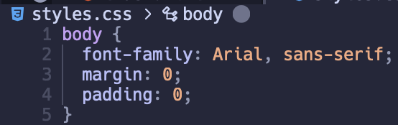
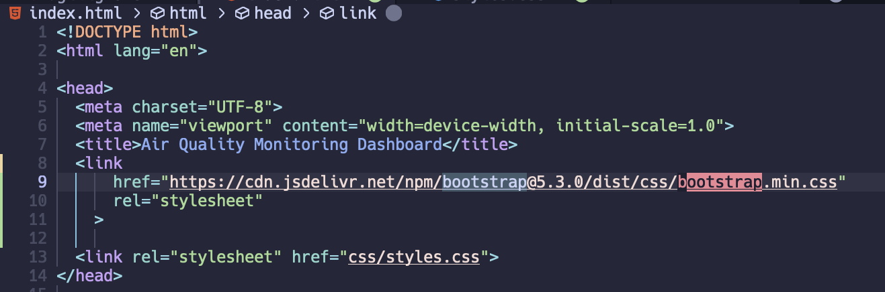
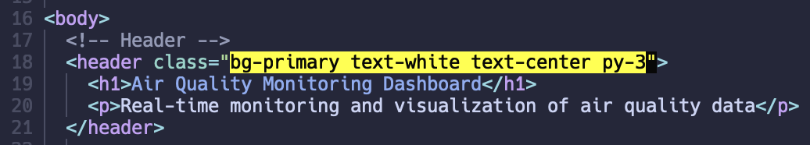
Project Layout Details (2/3)
CSS (styling)
css file (styles.css)
bootstrap
Import (line 9)
Usage (line 18)

Slide 10
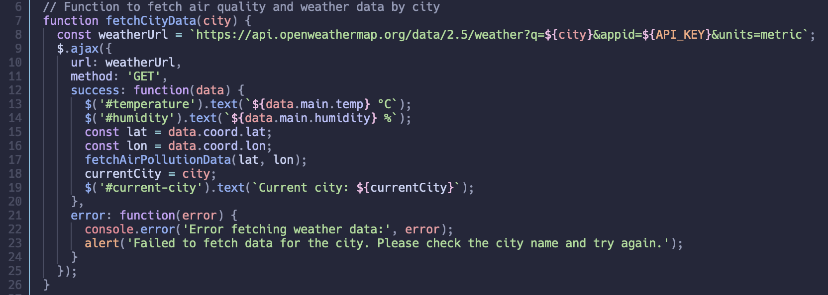
Project Layout Details (3/3)
Javascript (actions)
Fetching data
Openweather API, Ajax, JQuery

Slide 11
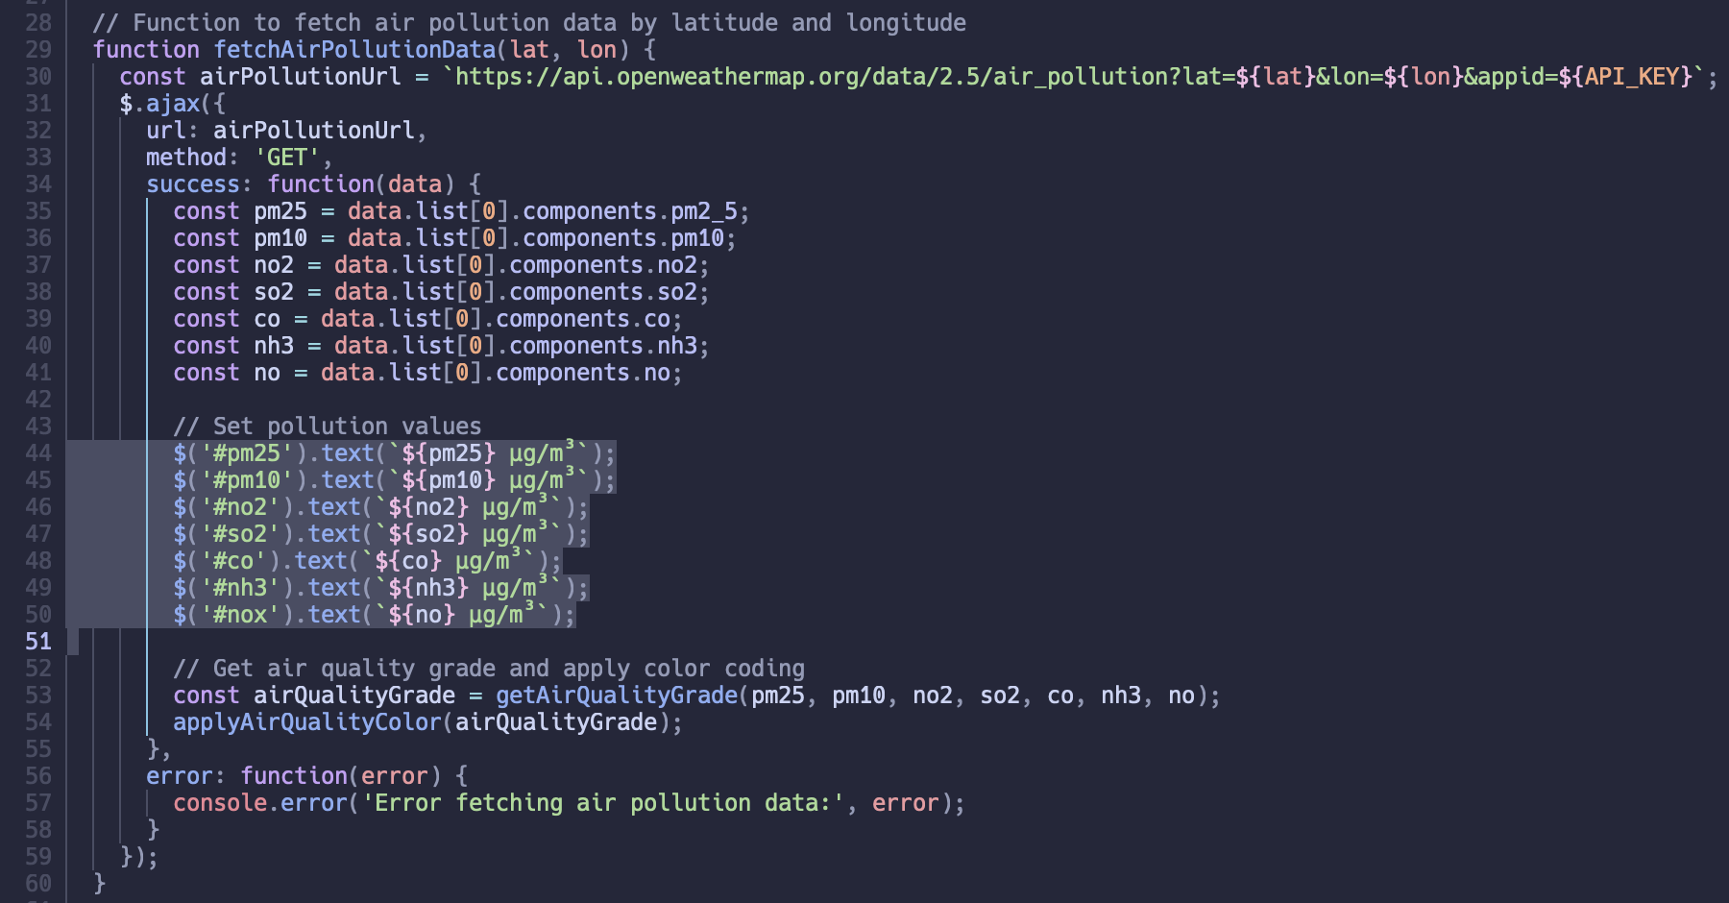
Project Layout Details (3/3)
Javascript (actions)
Rendering
JQuery

Slide 12
Key Features

Slide 13
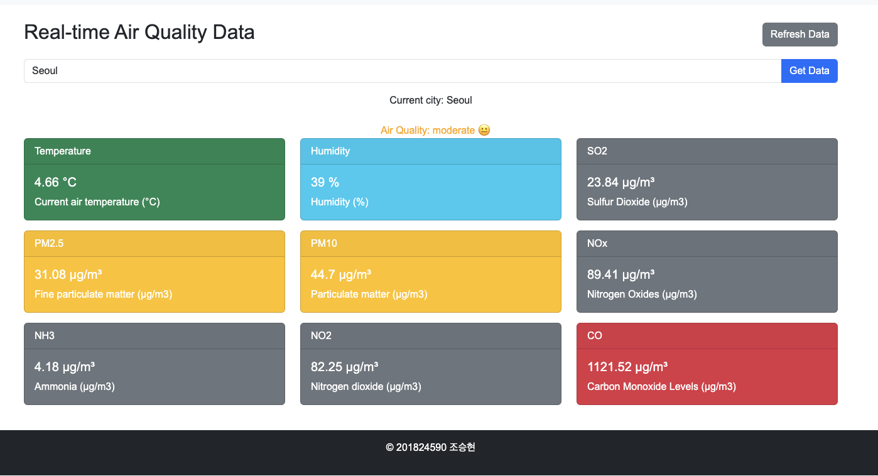
Key Features (1/2)
Real-time Air Quality Data from ‘city’

Slide 14
Key Features (1/2)
Real-time Air Quality Data from ‘city’
Displays up-to-date information for a selected city
Displays various air quality indicators visually, using different colors for easy distinction.
Displays intuitive air quality grades using text colors and emojis, enabling quick and easy assessment of air quality.
Allows users to search for city names and check the air quality status of multiple cities.

Slide 15
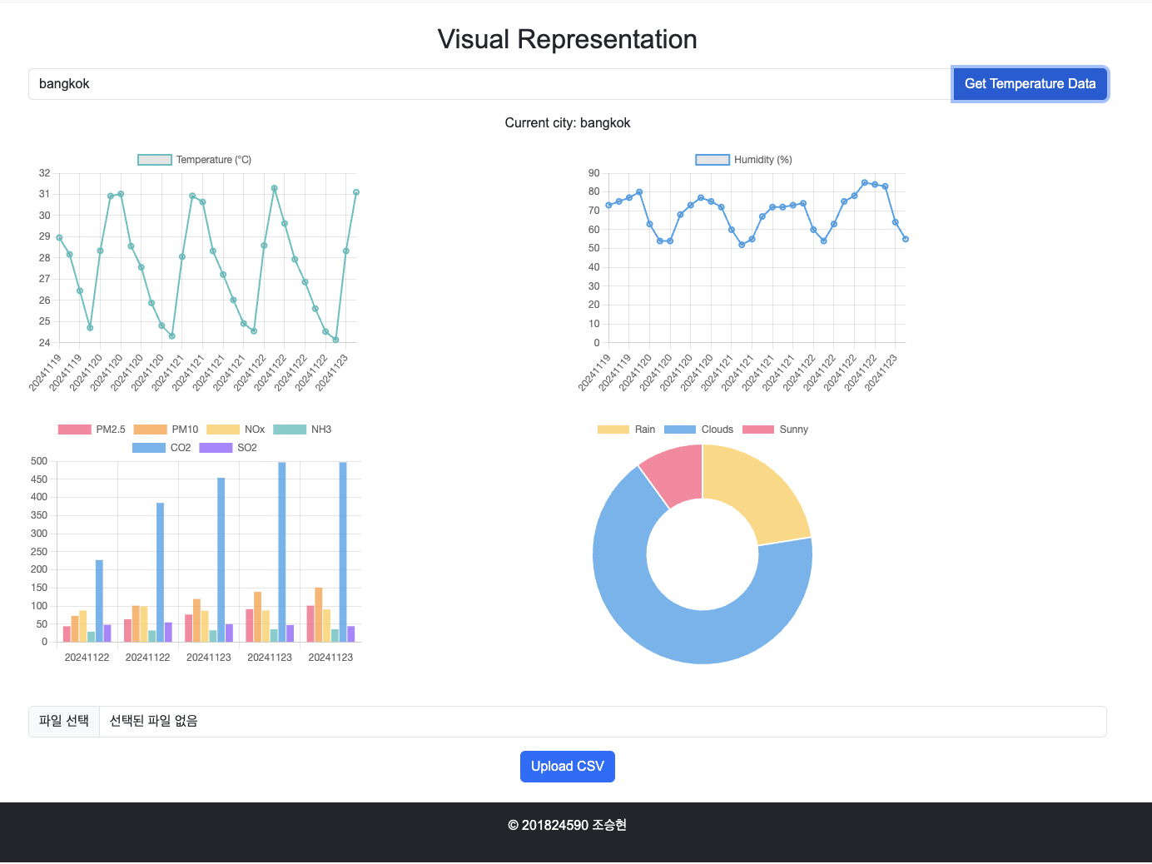
Key Features (2/2)
Visualize Air Quality Data in various charts

Slide 16
Key Features (2/2)
Visualize Air Quality Data in various charts
Displays temperature, humidity, and pollutant data through interactive graphs for a selected city.
Visualizes trends and variations in air quality metrics like PM2.5, CO2, and other pollutants using color-coded bar charts.
Allows users to upload CSV files for additional analysis and integrates weather conditions like rain, clouds, and sunny days in a pie chart.

Slide 17
Libraries used

Slide 18
Libraries & API used
Bootstrap 5 - For responsive styling and layout.
Chart.js - For creating dynamic charts to visualize temperature, humidity, and pollutant data.
jQuery - To manage DOM manipulation and handle API requests.
Moment.js - For date formatting.
PapaParse - For parsing CSV files to provide custom data.
OpenWeather API - To fetch real-time weather and pollution data.

Slide 19
TODO

Slide 20
TODO
Rank countries based on air quality scores
Create a leaderboard that ranks countries by their air quality to add an engaging, competitive aspect for users (gamification).
Improve UX for enhanced user interaction
Make the interface more intuitive, add helpful tooltips, and ensure smooth transitions for an overall better user experience.
Devise a solution to provide the service without exposing the API_KEY
Explore ways to securely store and manage the API_KEY to prevent unauthorized access, such as using a backend proxy or serverless functions.

Slide 21
Thank you

